Slide 1


Mini Project Synopsis Presentation
Deep Learning – Powered Criminal Investigations in CCTV Surveillance for Digital Crime Investigations
Team Members:
Lima Dsouza – 4SF21CD013
Adithi – 4SF21CD002
Nihara – 4SF21CD018
Mayur P S – 4SF21CD016
Under the Guidance of:
Dr. Navaneeth Bhaskar
Associate Professor
CSE(DS)/ISE, SCEM
Department of Computer Science and Engineering(Data Science)

Slide 2
Contents
Contents
Introduction
Problem Statement and Description
Objectives
Proposed Methodology
Outcome of the work
Conclusion

Slide 3
Introduction
Introduction
We know CCTV cameras are everywhere, there's a growing need for smarter technology to boost security and speed up criminal investigations.
Our proposed model, an advanced criminal face identification system for CCTV surveillance, steps in to meet this demand.
While CCTV cameras help monitor public spaces and important areas, going through all the video footage manually to identify people, especially those with criminal backgrounds, is slow and can lead to mistakes.
By automating the identification process using advanced facial recognition algorithms, our model aims to significantly cut down the time and effort usually spent on manual reviews.

Slide 4
Problem Statement
Problem Statement and Description
The rise of Closed-Circuit Television (CCTV) surveillance has overwhelmed law enforcement with an enormous amount of visual data.
Manually sifting through this footage to identify criminal faces is slow, error-prone, and often leads to delays.
The main problem is that traditional surveillance methods struggle to handle the sheer volume of video data and the need for quick and accurate identification of individuals with criminal backgrounds.

Slide 5
Problem Statement
Problem Statement and Description
Our proposed model, which incorporates advanced face recognition algorithms, deep learning, and Convolutional Neural Networks (CNNs) directly tackles this challenge.
The project aims to automate real-time criminal face identification, reducing investigation times, and enabling swift responses to security threats.
By closing the gap between the growing demand for efficient surveillance and the limitations of current practices, our model offers a revolutionary solution for improved public safety and more efficient criminal investigations.

Slide 6
Objectives
Objectives
The primary objective of the work is to design a smart model for automatically identifying the criminals from CCTV footage and to ensure the model is capable of accurately identifying criminal faces within CCTV footage
To design a deep learning algorithm for detection of the criminals and to implement efficient data preprocessing techniques to enhance the system's responsiveness
To develop a user-friendly interface that enables easy input of facial images, initiate real-time identification processes, and provide clear and actionable results.

Slide 7
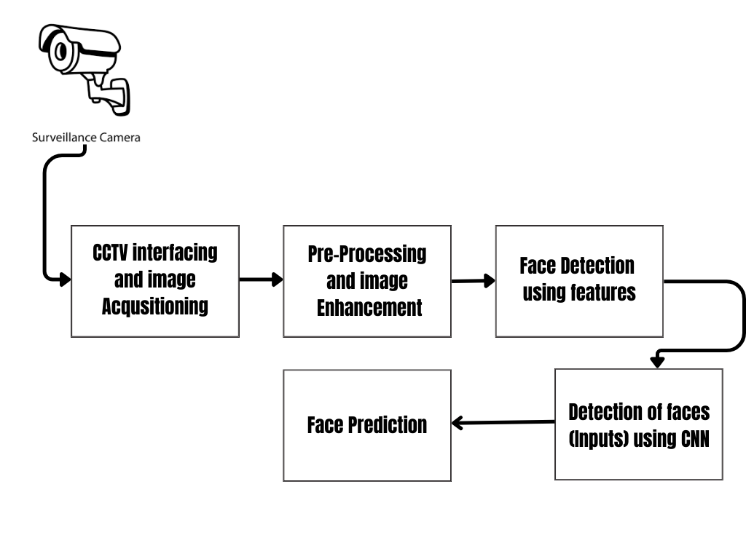
Proposed Methodology
Proposed Methodology
Criminal Identification in CCTV Surveillance for Digital Crime Investigations

Slide 8
Proposed Methodology
Proposed Methodology
CCTV Interfacing and Image Acquisition:
This step involves establishing a connection with the Closed-Circuit Television (CCTV) system to acquire video feeds. The goal is to interface with the CCTV cameras, access the video streams, and capture the frames/images for further analysis.
Preprocessing and Image Enhancement:
Preprocessing involves cleaning and enhancing the images to improve the performance of subsequent analysis.

Slide 9
Proposed Methodology
Proposed Methodology
Face Detection Using Features:
This step involves the identification of faces within the preprocessed images using relevant facial features.
Detection of Faces Using CNN:
Convolutional Neural Networks (CNNs) are powerful deep learning models widely used for image-related tasks. This step involves employing a CNN for more accurate and robust face detection, leveraging the network's ability to automatically learn hierarchical features.

Slide 10
Proposed Methodology
Proposed Methodology
Face Prediction:
Once faces are detected, the next step is to predict or recognize the identities of individuals. This may involve comparing facial features with a database of known individuals or training a model for facial recognition.

Slide 11
Hardware/Software Requirements
Requirements
CCTV Dataset:
Collect a diverse dataset of CCTV footage with labeled criminal and non-criminal faces for training and testing the model.
User-Friendly Interface:
Provide an intuitive interface for law enforcement personnel.
Adaptability and Continuous Learning with CNN:
Incorporate mechanisms for continuous learning and adaptation using CNN-based models.

Slide 12
Hardware/Software Requirements
Requirements
Python libraries:
OpenCV: For image and video processing.
NumPy: For mathematical calculations and analyzation.
TensorFlow or PyTorch: Deep learning frameworks for building and training neural networks.
scikit-learn: For machine learning utilities and evaluation metrics.
dlib: A library for face detection and facial landmark estimation.

Slide 13
Outcome of the work
The model will be utilized in crime investigation sectors where it will play a crucial role in predicting criminals.
Improved efficiency in criminal investigations by reducing the time required to identify persons of interest in video recordings.
User-friendly interface for law enforcement agencies to easily interact with the system for real-time identification.
Rapid identification of persons of interest aids in swift response to potential threats, allowing law enforcement to take proactive measures and mitigate risks promptly. This enhances the ability of law enforcement agencies to maintain a safer environment for the community.

Slide 14
Conclusion
The proposed model introduces an advanced application in computer vision and facial recognition tailored for criminal investigations.
Its core objective is to take an individual's image as input, analyze CCTV video footage, and ascertain the person's presence in the video.
This innovative approach simplifies law enforcement tasks, automates identification, and ensures quick responses to potential security threats.
Situated at the crossroads of artificial intelligence, deep learning-CNN’s, and surveillance technologies, the project significantly contributes to modernizing security practices and optimizing criminal investigations.

Slide 15
References
References
Matsugu, M., Mori, K. and Suzuki, T., 2004. Face recognition using SVM combined with CNN for face detection. In Neural Information Processing: 11th International Conference, ICONIP 2004, Calcutta, India, November 22-25, 2004. Proceedings 11 (pp. 356-361). Springer Berlin Heidelberg.
Tao, Q.Q., Zhan, S., Li, X.H. and Kurihara, T., 2016. Robust face detection using local CNN and SVM based on kernel combination. Neurocomputing, 211, pp.98-105.
Wang, J. and Li, Z., 2018, July. Research on face recognition based on CNN. In IOP Conference Series: Earth and Environmental Science (Vol. 170, No. 3, p. 032110). IOP Publishing.

Slide 16
Thank You

